Slide 1
III Unit Root Tests
Why do we need the test?
DF and ADF tests
Type I and II Errors
Other Unit Root Tests

Slide 2
1. Stationarity and Unit Root Testing
Why do we need to test for Non-Stationarity?
The stationarity or otherwise of a series can strongly influence its behaviour and properties - e.g. persistence of shocks will be infinite for nonstationary series
Spurious regressions. If two variables are trending over time, a regression of one on the other could have a high R² even if the two are totally unrelated
If the variables in the regression model are not stationary, then it can be proved that the standard assumptions for asymptotic analysis will not be valid. In other words, the usual “t-ratios” will not follow a t-distribution, so we cannot validly undertake hypothesis tests about the regression parameters.

Slide 3
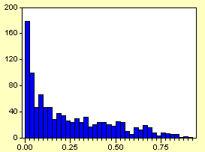
Value of R² for 1000 Sets of Regressions of a
Non-stationary Variable on another Independent Non-stationary Variable

Slide 4
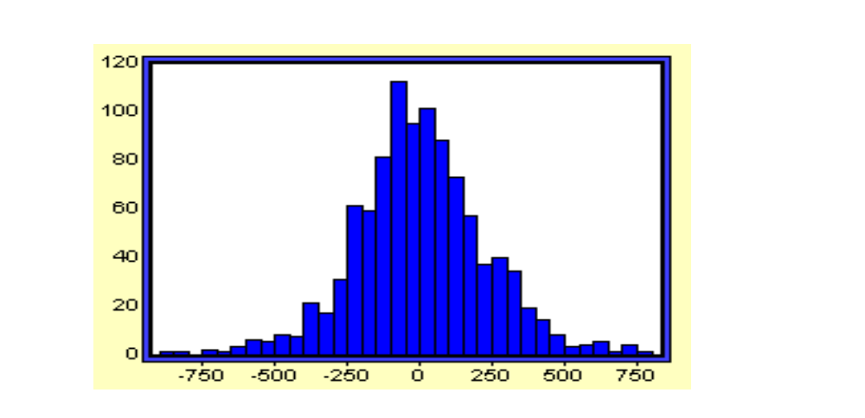
Value of t-ratio on Slope Coefficient for 1000 Sets of Regressions of a Non-stationary Variable on another Independent Non-stationary Variable

Slide 5
Two types of Non-Stationarity
Various definitions of non-stationarity exist (usually we use the covariance stationarity).
There are two models which have been frequently used to characterise non-stationarity: (i). the random walk model with drift:
y_{t} = μ + φy_{t-1} + ε_{t}, φ≧1 (1)
(ii). the deterministic trend process:
y_{t} = α + βt + ε_{t} (2)
where ε_{t} is iid in both cases.

Slide 6
Stochastic Non-Stationarity
Note that the model (1) could be generalised to the case where y_{t} is an explosive process:
y_{t} = μ + φy_{t-1} + ε_{t}, φ>1
Typically, the explosive case is ignored and we use φ = 1 to characterise the non-stationarity because
  φ > 1 does not describe many data series in economics and finance.
  φ > 1 has an intuitively unappealing property: shocks to the system are not only persistent through time, they are propagated so that a given shock will have an increasingly large influence.

Slide 7
Stochastic Non-stationarity: The Impact of Shocks
To see this, consider the general case of an AR(1) with no drift:
y_{t} = μ + φy_{t-1} + ε_{t} (3)
Let φ take any value for now.
We can write: y_{t} = μ + φy_{t-1} + ε_{t}
y_{t-1} = μ + φy_{t-2} + ε_{t-1}…
Substituting into (3): y_{t} = φ(φy_{t-2} + ε_{t-1}) + ε_{t} = φ²y_{t-2} + φε_{t-1} + ε_{t}
Substituting again for y_{t-2}: y_{t} = φ³y_{t-3} + φ²ε_{t-2} + φε_{t-1} + ε_{t}
Successive substitutions lead to:
y_{t} = φ ^{t} y₀ + φ ^{t-1} ε₁ + φ^{t-2} ε₂ +…+φ²ε_{t-2} + φε_{t-1} + ε_{t}

Slide 8
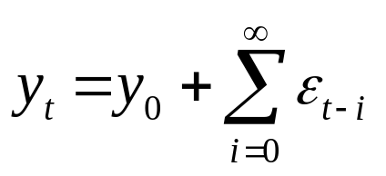
The Impact of Shocks for
Stationary and Non-stationary Series
We have 3 cases:
1. φ<1 ⇒ φ^{t}→0 as t→∞
So the shocks to the system gradually die away.
2. φ=1 ⇒ φ^{t} =1∀ t
So shocks persist in the system and never die away. We obtain:
as t→∞
So just an infinite sum of past shocks plus some starting value of y₀.
3. φ>1. Now given shocks become more influential as time goes on, since if φ>1, φ³>φ²>φ etc.

Slide 9
Detrending a Stochastically Non-stationary Series
Going back to our two characterisations of non-stationarity, the r.w. with drift:
y_{t} = μ + y_{t-1} + ε_{t}, (1)
and the trend-stationary process
y_{t} = α + βt + ε_{t}. (2)
The two will require different treatments to induce stationarity. The second case is known as deterministic non-stationarity and what is required is detrending.
The first case is known as stochastic non-stationarity. If we let Δy_{t} =y_{t}-y_{t-1} = μ + ε_{t},
We say that we have induced stationarity by “differencing once”.

Slide 10
Detrending a Series: Using the Right Method
Although trend-stationary and difference-stationary series are both “trending” over time, the correct approach needs to be used in each case. If we first difference the trend-stationary series, it would “remove” the non-stationarity, but at the expense on introducing an MA(1) structure into the errors. (Δy_{t} = β + ε_{t}- ε_{t-1})
Conversely if we try to detrend a series which has stochastic trend, then we will not remove the non-stationarity. (Kang and Nelson, 1984)
We will now concentrate on the stochastic non-stationarity model since deterministic non-stationarity does not adequately describe most series in economics or finance.

Slide 11
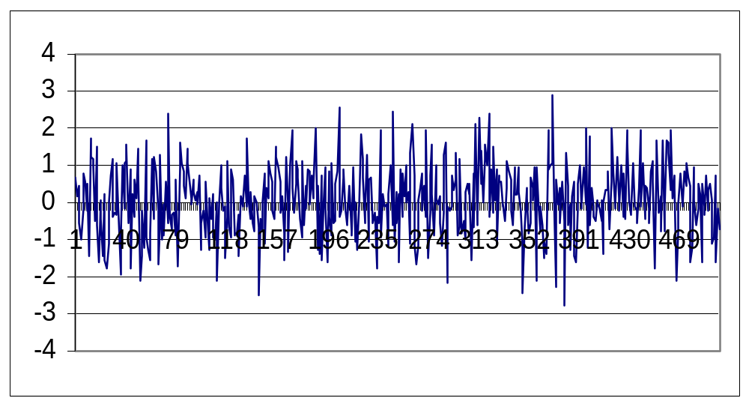
Sample Plots for various Stochastic Processes:
A White Noise Process

Slide 12
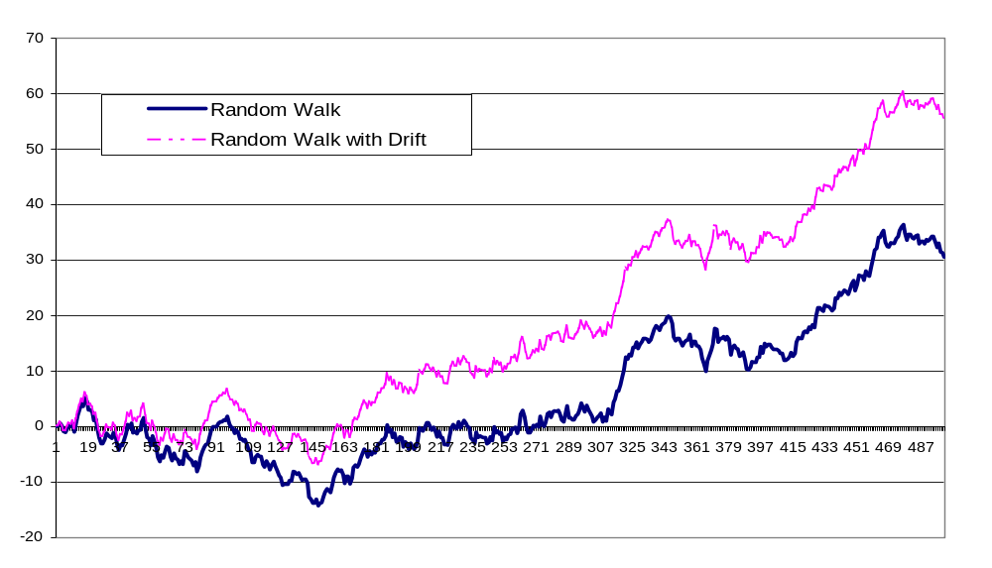
Sample Plots for various Stochastic Processes:
A Random Walk and a Random Walk with Drift

Slide 13
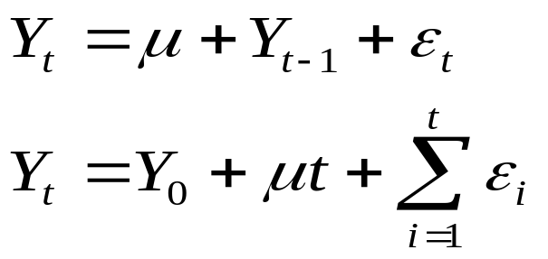
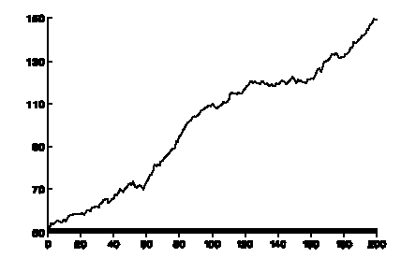
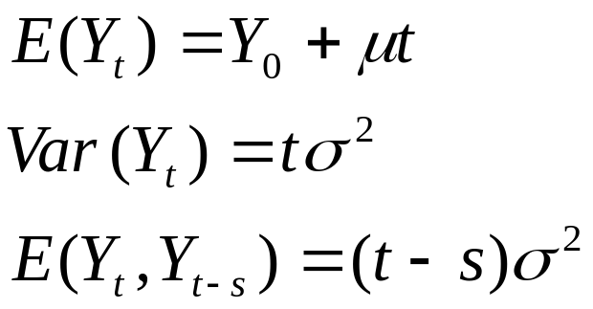
A RW with drift
The drift term gives the positive or negative trend in the RW.

Slide 14
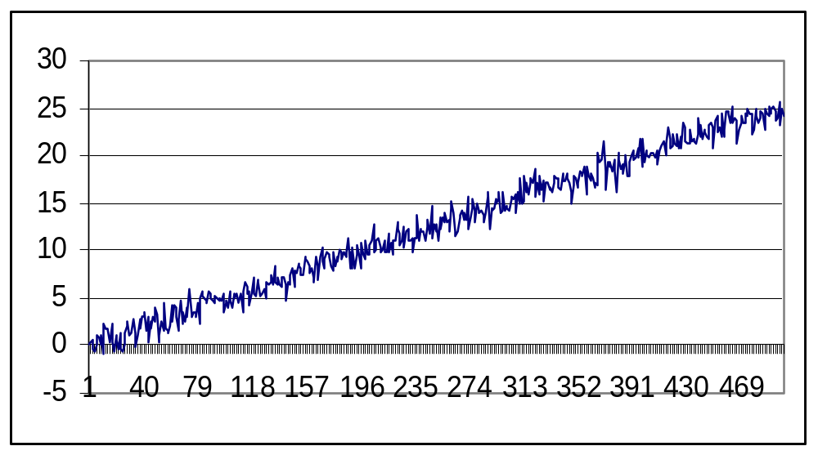
Sample Plots for various Stochastic Processes:
A Deterministic Trend Process

Slide 15
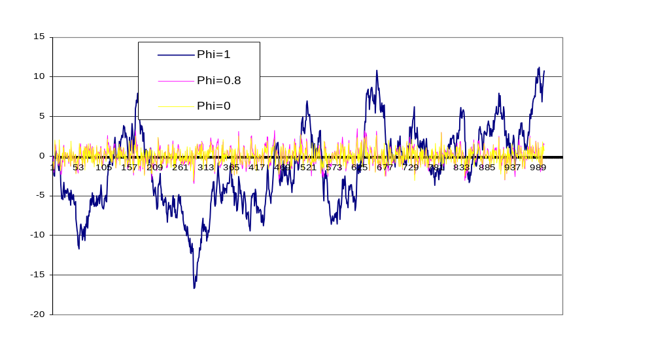
Autoregressive Processes with differing values of φ (0, 0.8, 1)

Slide 16
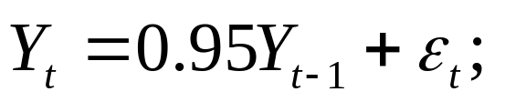

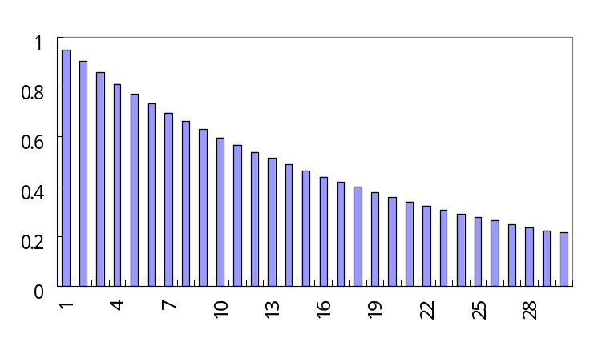
A near random walk
Does it make much difference to the characteristics of the process if is close to but actually below 1?
Plotting the realizations of Y: even if Y temporarily diverges, suggesting that it may wander, it again crossed the zero axis
It has a relatively long memory
ACFs are dying out slowly-
but the memory is not infinite.

Slide 17
Definition of Non-Stationarity
Consider again the simplest stochastic trend model:
y_{t} = y_{t-1} + ε_{t},
or Δy_{t} = ε_{t}
In general, the series can contain more than one “unit root”, that is, we would need to apply the first difference operator, Δ, more than once to induce stationarity.
Definition
If a non-stationary series, y_{t} must be differenced d times before it becomes stationary, then it is said to be integrated of order d. We write y_{t} ∼I(d).
So if y_{t} ∼ I(d) then Δ^{d}y_{t}∼ I(0).

Slide 18
Characteristics of I(0), I(1) and I(2) Series
An I(2) series contains two unit roots and so would require differencing twice to induce stationarity.
I(1) and I(2) series can wander a long way from their mean value and cross this mean value rarely.
I(0) series should cross the mean frequently.
The majority of economic and financial series contain a single unit root, although some are stationary and consumer prices have been argued to have 2 unit roots.

Slide 19
2. How do we test for a unit root?
The early and pioneering work on testing for a unit root in time series was done by Dickey and Fuller (Dickey and Fuller 1979, Fuller 1976).
The basic objective of the test is to test the null hypothesis that φ =1 in: y_{t} = φy_{t-1} + ε_{t}
against the one-sided alternative φ <1. So we have
H₀: series contains a unit root
vs. H₁: series is stationary.
We usually use the regression: Δy_{t} = γy_{t-1} + ε_{t}
so that a test of φ=1 is equivalent to a test of γ=0.

Slide 20
Different forms for the DF Test Regressions
Dickey Fuller tests are also known as τ tests: τ, τ_{μ}, τ_{τ}.
The null and alternative models in each case are
(i) H₀: y_{t} = y_{t-1} + ε_{t}
H₁: y_{t} = φy_{t-1} + ε_{t}, φ<1
This is a test for a random walk against a stationary autoregressive process of order one (AR(1))
(ii) H₀: y_{t} = y_{t-1} + ε_{t}
H₁: y_{t} = μ+φy_{t-1} + ε_{t}, φ<1
This is a test for a random walk against a stationary AR(1) with a constant term.
iii) H₀: y_{t} = y_{t-1} + ε_{t}
H₁: y_{t} = μ+λt+φy_{t-1} + ε_{t}, φ<1
This is a test for a random walk against a stationary AR(1) with drift and a time trend.

Slide 21
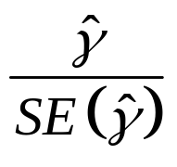
Computing the DF Test Statistic
Campbell and Perron’s article (1991, NBER) provides rules (of thumb) for investigating whether time series contain unit roots.
It depends on:
  The maintained model.
  The null hypothesis and
  the form of alternative hypotheses.
The tests are based on the t-ratio on the y_{t-1} term in the estimated regression of Δy_{t} on y_{t-1}, Δy_{t} = μ+λt+ γy_{t-1} + ε_{t} (with μ=λ=0 in case (i), and λ=0 in case (ii)
The test statistics =

Slide 22
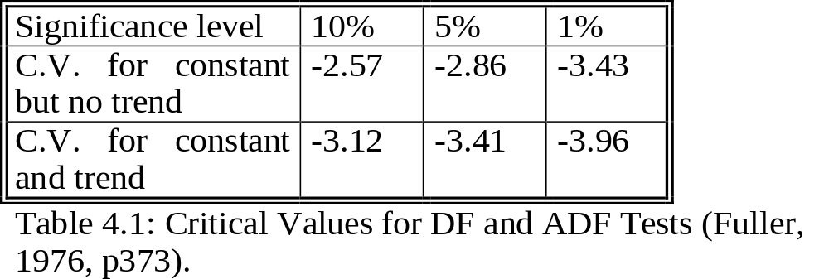
Critical Values for the DF Test
The test statistic does not follow the usual t-distribution under the null, but rather follows a non-standard distribution. Critical values are derived from Monte Carlo experiments in, for example, Fuller (1976). Relevant examples of the distribution are shown in the table below
The null hypothesis of a unit root is rejected in favour of the stationary alternative in each case if the test statistic is more negative than the critical value.

Slide 23
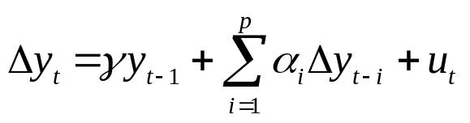
The Augmented Dickey Fuller (ADF) Test
The tests above are only valid if ε_{t} is white noise.
But, ε_{t} will be autocorrelated if there was autocorrelation in the dependent variable of the regression (Δy_{t}) which we have not modelled.
The solution is to “augment” the test using p lags of the dependent variable. The alternative model in case (i) is now written:
The same critical values from the DF tables are used as before. A problem now arises in determining the optimal number of lags of the dependent variable. There are two ways
  use the frequency of the data to decide
  use information criteria

Slide 24
Testing for Higher Orders of Integration
Consider the simple regression: Δy_{t} = γy_{t-1} + ε_{t}
We test H₀: γ=0 vs. H₁: γ <0.
If H₀ is rejected we simply conclude that y_{t} does not contain a unit root.
But what do we conclude if H₀ is not rejected?
The series contains a unit root, but is that it?
No! What if y_{t} ∼I(2)?
We would still not have rejected. So we now need to test
H₀: y_{t} ∼I(2) vs. H₁: y_{t} ∼I(1)

Slide 25
Testing for Higher Orders of Integration
H₀: y_{t} ∼I(2) vs. H₁: y_{t} ∼I(1)
  We now regress Δ²y_{t} on Δy_{t-1} (plus lags of Δ²y_{t} if necessary).
  Now we test H₀: Δy_{t} ∼I(1) which is equivalent to H₀: y_{t} ∼I(2).
So in this case, if we do not reject (unlikely), we conclude that y_{t} is at least I(2). We would continue to test for a further unit root until we rejected H₀.

Slide 26
Unit root test
It tests whether realizations have been generated from an I(1) model rather than an I(0) model
Risk of ‘power’ of the test: prob. of rejecting the null of I(1) when the alternative is true
Dickey and Fuller (1979, 1981): DF test
Phillips and Perron (1988): PP test

Slide 27
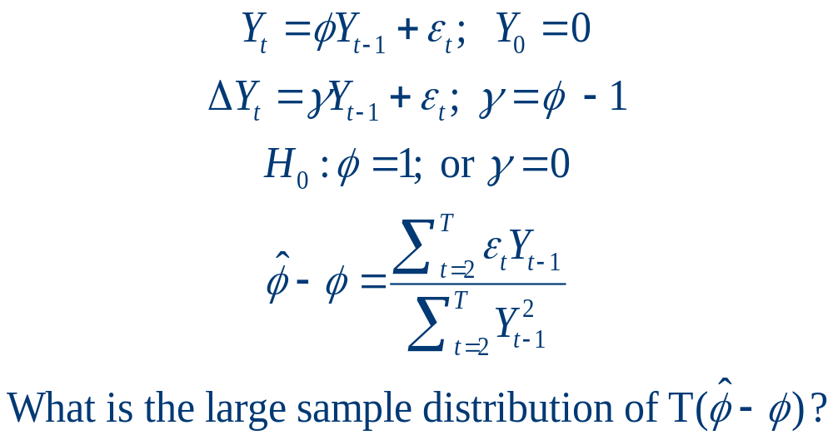
Test statistics

Slide 28
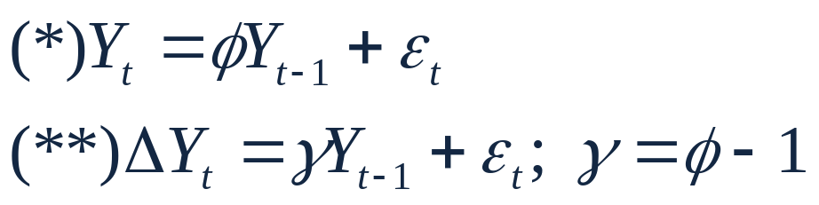
Since φ >1, or γ >0 would imply an explosive model, it is customary to only conduct one sided tests on γ.
Acceptance of the null, γ=0, implies that the model can be expressed totally in terms of changes in the variable. Rejection of the null (→γ<0) implies that (*) or (**) is appropriate. Thus this test based on (**) is useful in distinguishing between levels and differences.

Slide 29

t statistics ~ Normal?
Standard t-test or asymptotic normal test should not be used for the test γ=0.
  The null implies a regressor has infinite variance
  The violation of a basic least squares assumption invalidates the assumption of asymptotic normality.
Under the null, the distribution of the test statistics: t-ratio for ~Dickey-Fuller test

Slide 30
Dickey-Fuller test
Following Fuller (1976), the τ test statistic is not normal, thus we should not use critical values from normal or student t table. The right table to look at is Fuller (1976, p. 373).
They depends on whether the constant is zero, or there is a time trend in the equation that generates the data.
The τ test statistic table can be constructed by simulation.

Slide 31
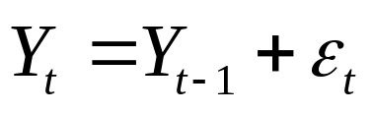
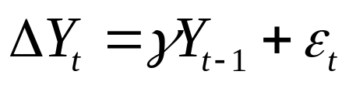
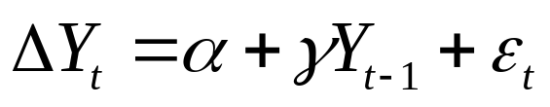
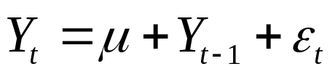
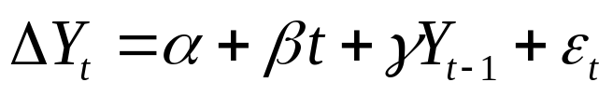
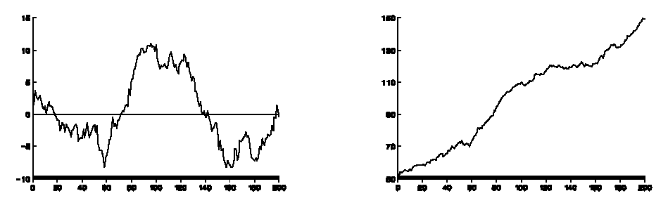
Critical values depend on DGP and regression models
True model (DGP)
Regression model
Case 1
Case 2
Case 3

Slide 32
3. Type I Error
We are never 100% confident on our conclusion. We must allow some probability of committing a mistake or the probability of rejecting the correct hypothesis or punishing the innocent people.
Define:
  α = probability of Type I Error or significance level
  1-α = confidence level
Based upon the sampling distribution of the estimator for the parameter, the acceptance region and the rejection region for the statistics can be established (using the probability tables provided).

Slide 33
3. Type II Error
If the real value of the parameter is different from the hypothesized value or H₀ is wrong, the evidence may lead to the wrong conclusion that H₀ is correct.
This mistake is called Type II Error. However, the assumption about the real value of the parameter must be made. If the real value is not much different from the hypothesized value, then it is more likely that H₀ will be accepted while it is not correct or Type II Error will be made.
Prob{Type II Error|real value}
  = a function of the real value.
It is an indicator for Power of Test. If the test is vulnerable to Type II error it has low Power of Test. If the test can distinguish a false value from the real value it has Power of Test.

Slide 34
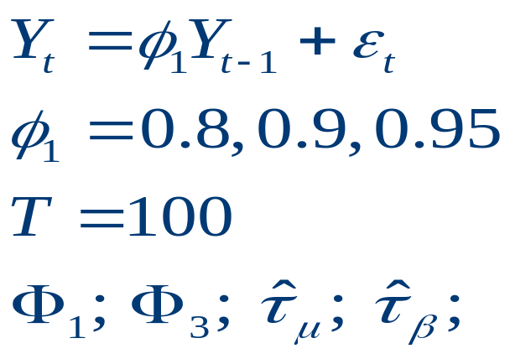
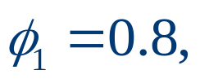
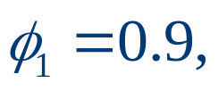
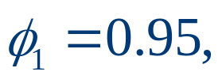
3. Power of Test: Type II error
H_{A}:
Φ₁ ; significance level (the size): 5%
  80% of the simulations with reject null
  24% of the simulations with reject null
  9% of the simulations with reject null

Slide 35

3. Power problem of unit root test
When the alternative close to 1, power is low; i.e. false non-rejection of the null (type II error) is frequent
Empirical power approaches the size (significant level) of the test as
When significant level is low so is the power; can we reverse the role of hypothesis H_{A} → H₀?
we still have a “Near observational equivalence”
Raise the significance level from 5% to 10 or 20%; trade off type I and type II errors

Slide 36
3. Type I error: the size
Type I error = prob (falsely rejecting the null that a time series contains a unit root)
Testing strategies involve more than one test; τ_{β}, τ_{μ}; higher overall type I error: 5~10 %
Reduce the significant level at each stage; but the power is also low for near unit root time series

Slide 37
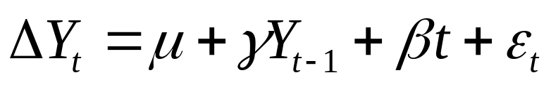
3. Ayat and Burridge’s sequential procedure (2000, J. of Econometrics, 95, pp. 71-96)
1. Estimate (*)
  H₀: γ =0 → t-test (DF, ADF)
2 (a) if not rejecting unit root, maintain this hypothesis, test for the presence of time trend
  Δy_{t} = μ + β t + ε_{t}
  H₀: β =0 → standard t-test
2(b) if unit root is rejected, test β =0 in (*)

Slide 38
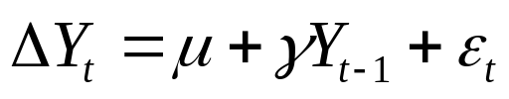
3. Sequential procedure
3(a)
  if β = 0 rejected in 2(a) → data have a unit root and a linear trend (a RW with drift)
  If β = 0 rejected in 2(b) → the process is stationary around a linear trend.
  We can stop here.
3(b)
  If β = 0 not rejected in 2(a) → a unit root test w/o trend is more powerful, so estimate:
  Perform a second unit root test using t-test
  If β = 0 not rejected in 2(b) → the process is I(0) w/o trend, stop here

Slide 39
(*)
H₀: γ =0 → t-test (DF, ADF)
Step 1
not rejecting
rejecting
  Δy_{t} = μ + β t + ε_{t}
  H₀: β =0
  standard t-test
test β =0 in (*)
Step 2
rejecting
not rejecting
rejecting
not rejecting
Step 3
I(0) around a linear trend
  I(0), no trend
  a unit root and a linear trend
a unit root test w/o trend is more powerful, so estimate
  I(0), no trend
rejecting
Second unit root test
  RW with drift

